Slide 1

Workplace assistant augmented reality
Gabriel Camilleri

Slide 2
Problem Definition

Slide 3

Problem Definition
To build a real-time assisting application which can help interns and visitors easily adjust within a workplace
An application which would addresses job fitness for new employees
To provide an assistant augmented reality application
Applying object and image recognition in combination with the right user profiling and recommendation techniques.

Slide 4
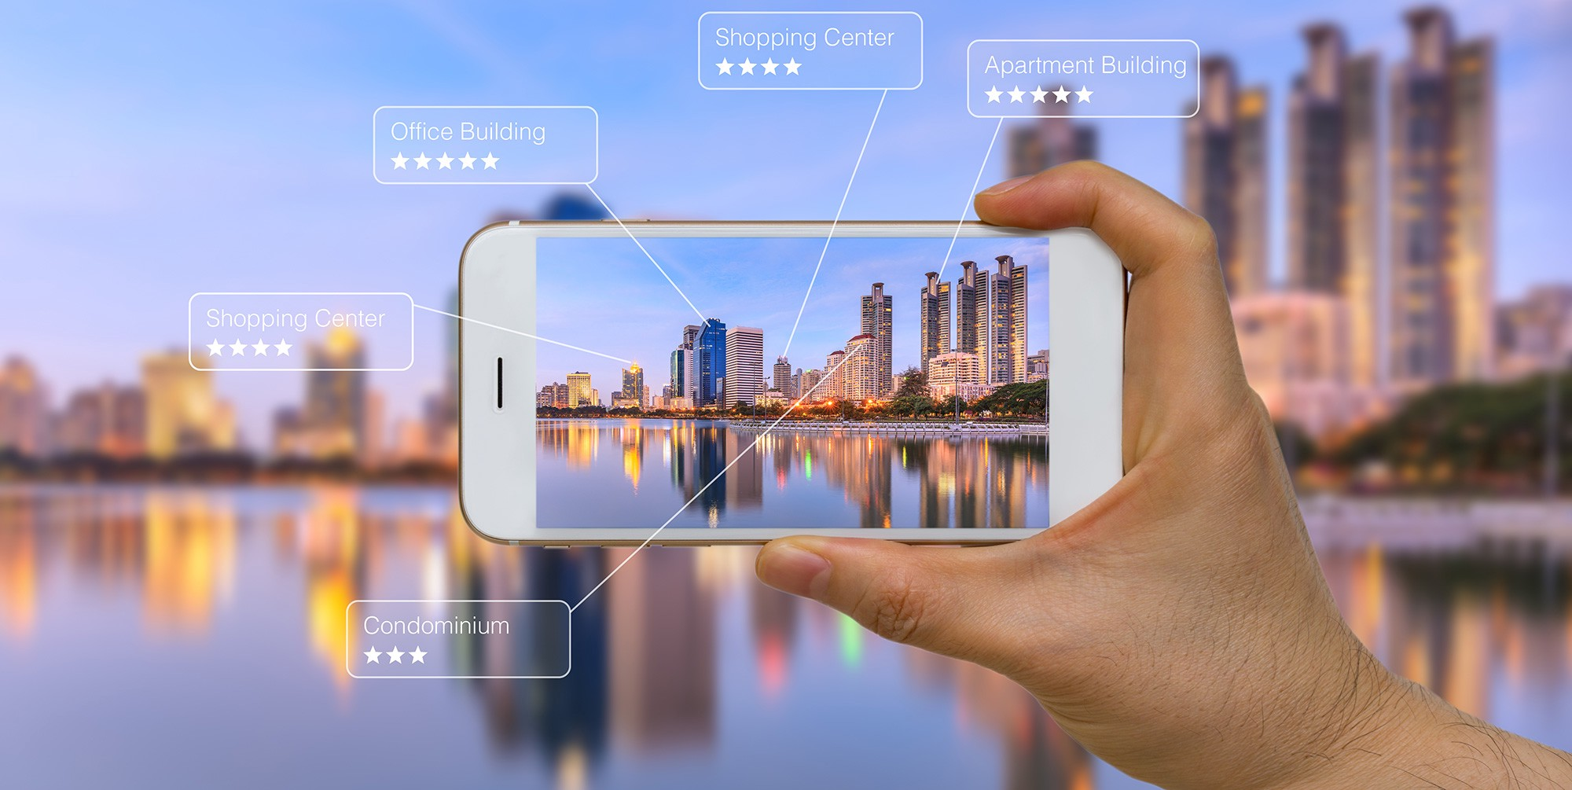
Research Questions
Which is the right Augmented Reality Library for the current context?
What are the right computer vision techniques to apply?
What models and techniques are suitable to implement user profiling and recommendation depending on the user’s task at hand?

Slide 5
Design and Implementation

Slide 6
The 3 Main Components of the System
The user
Augmented Reality
User Recommendation System

Slide 7

Data Handling
AR component
Images were taken
Initially of corridors
Feature extraction problem
Specific door signs were chosen as markers
Had unique distinct features
3D models were generated (11 in total)
Recommendation Component
A prototype dataset was built from scratch containing user-ratings
3 datasets in total for 3 separate tasks for the Visitors
Visit
Delivery
Interview

Slide 8
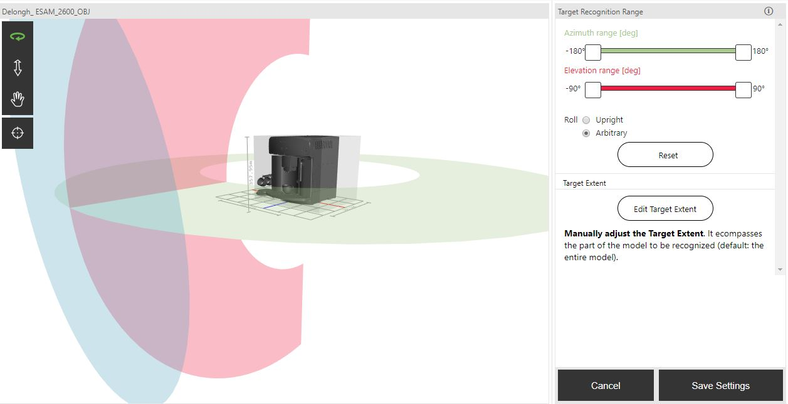
Feature Extraction
Images were fed into Vuforia’s library and were processed using traditional CV techniques.
Detecting edges and contours
3D objects were fed to Vuforia’s model generator to perform deep learning techniques on.
Detecting edges and contours at different lightings, distances, and angles.
Dataset built using different frames of the same object

Slide 9
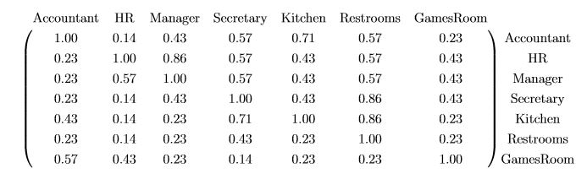
Feature Extraction (Cont)
User Recommendations
Collaborative Filtering
Features, were user ids, task ids and ratings.
Fed to SVD++ model
Matrix Factorisation method
Item-item similarity based matrix
Based on term frequency
Visibility based
Normalised
Based on the amount of times an office (term) is passed by the user while finding an office in particular (document)
Did not apply tf-idf
matrix scaling was done using one-fold normalisation since a term (a location within the office) appears in every task (a task is equivalent to a document)

Slide 10
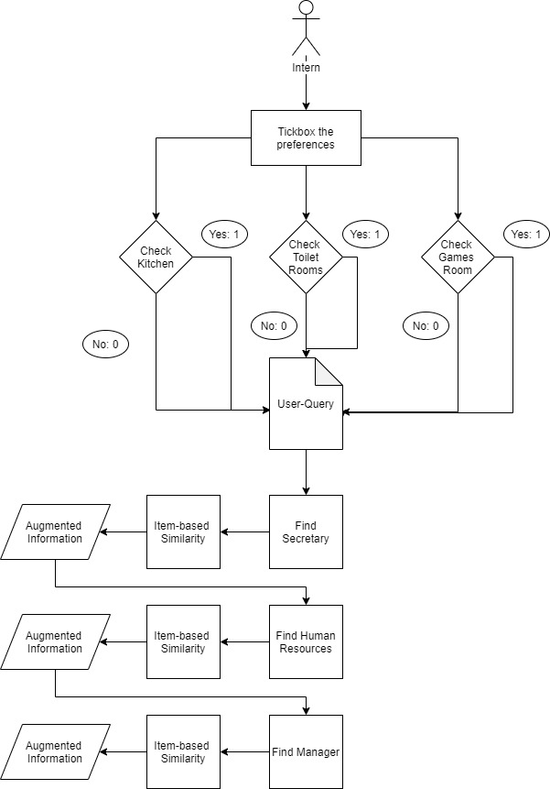
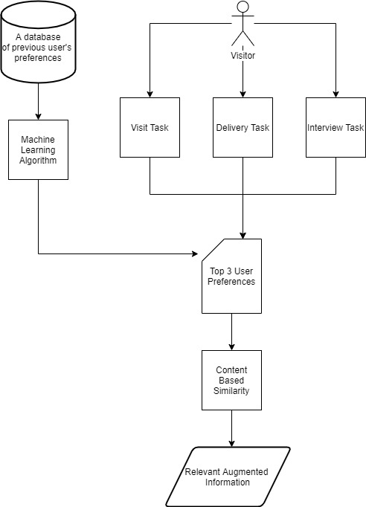
User-Query Models
Intern-Query Model
Visitor-Query Model

Slide 11
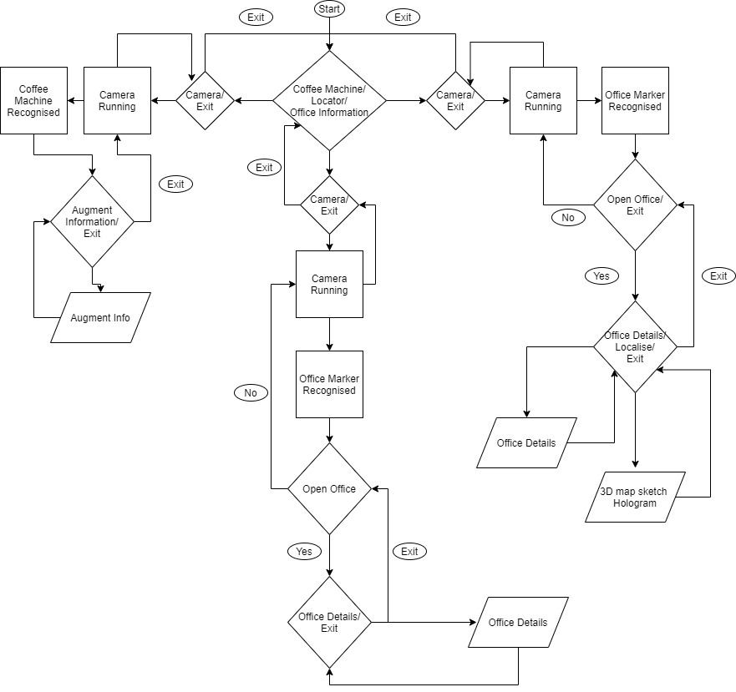
Architecture
Offices Information
(wandering around)
Locator
Intern
Step By step process
Secretary
HR
Manager
Visitor
Profiling on:
Visit
Interview
Delivery
Coffee Machine

Slide 12
Testing And Evaluation

Slide 13
Quantitative AR Testing
Testing cannot be done on the algorithms’ performances of the library as developers do not have complete access to the API.
Common methods of the AR app’s tests are on the following component:
Colour Variance
Distance Variance
Orientation Variance
Occlusion Variance
Each test repeated a total of 21 times
10 – Image Targets
11 – Model Targets

Slide 14
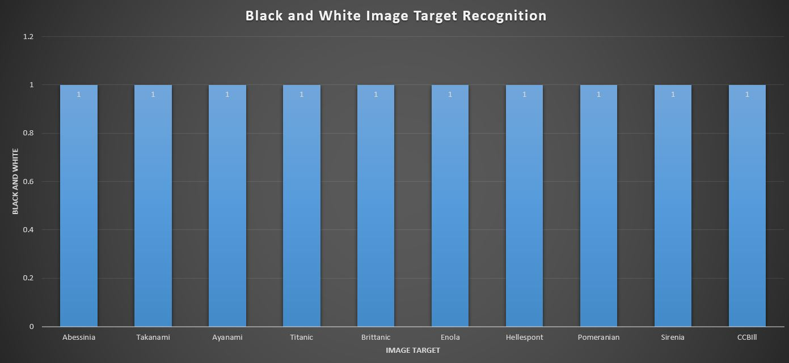
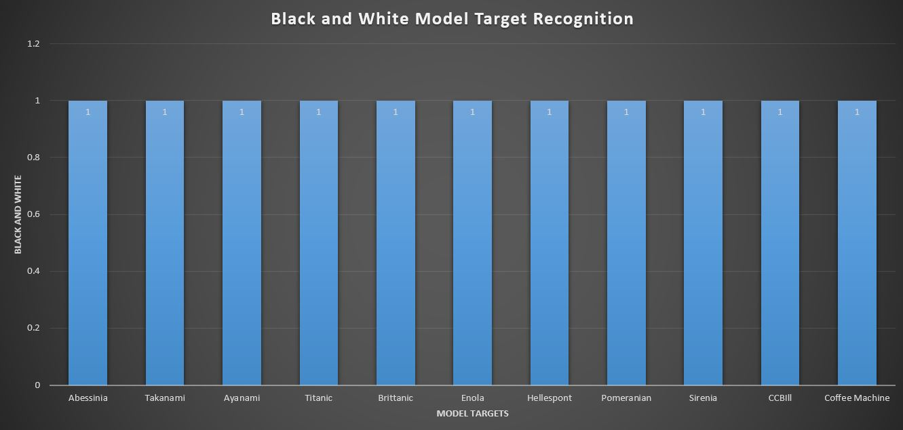
Colour Variance
Image Targets
Model Targets

Slide 15
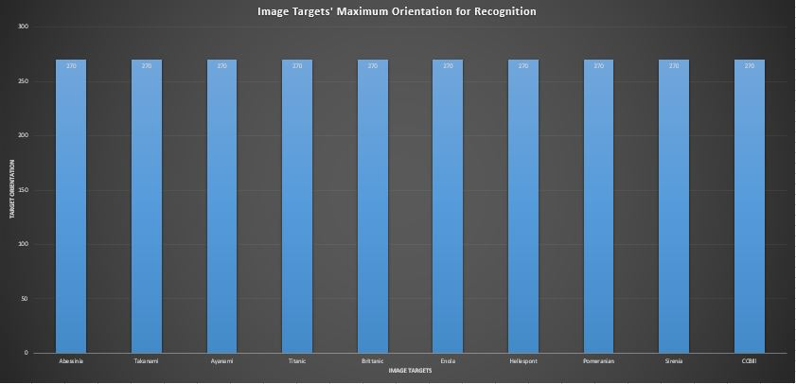
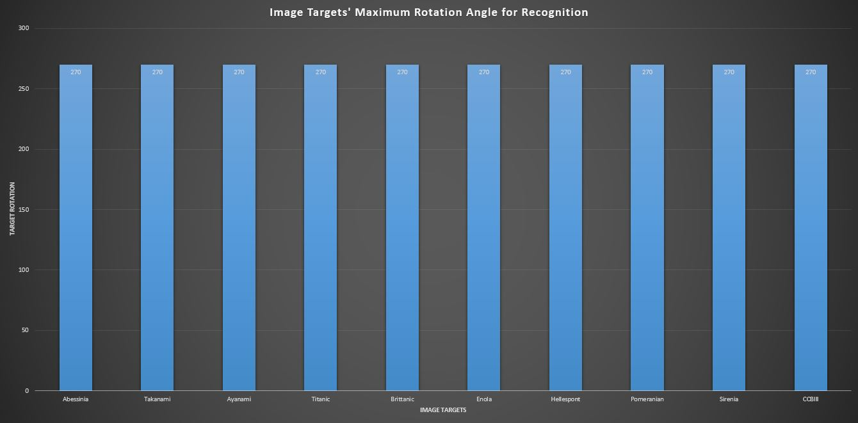
Orientation Variance
Image Targets
Model Targets

Slide 16
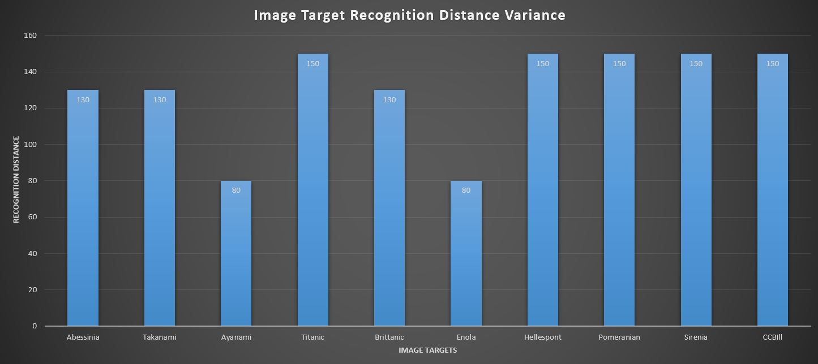
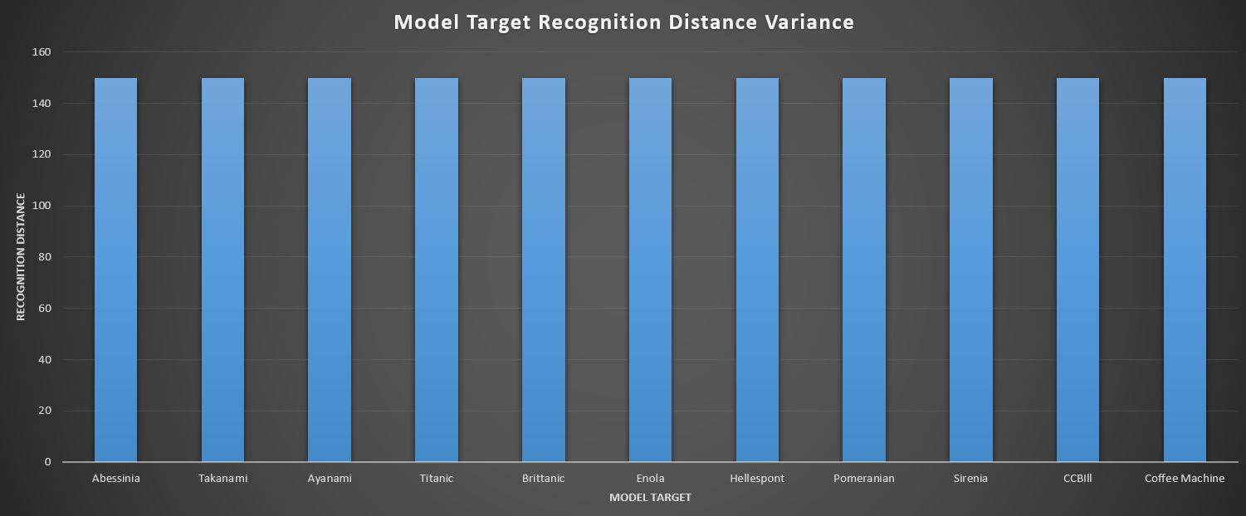
Distance Variance
Image Targets
Model Targets

Slide 17
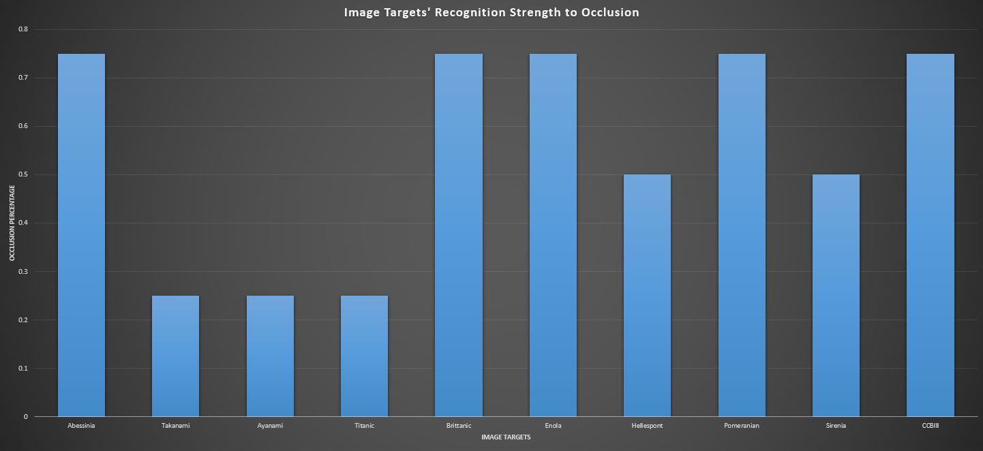
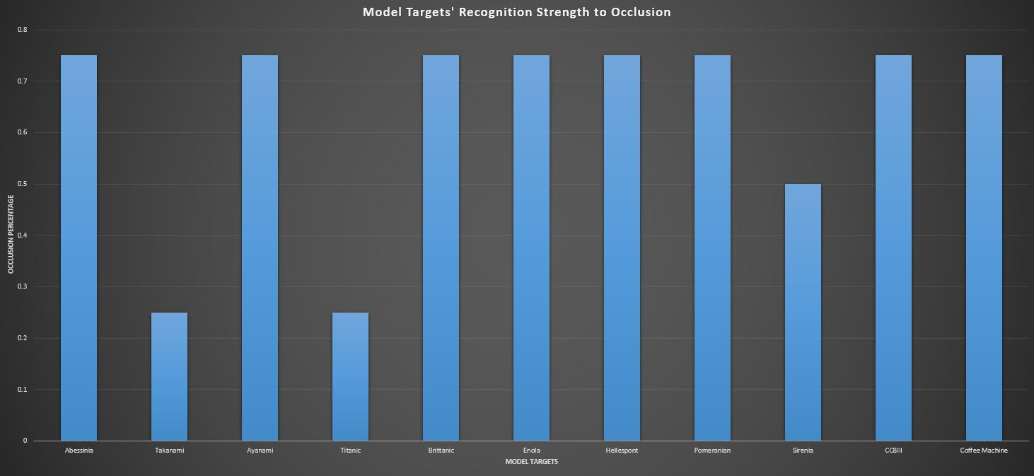
Occlusion Variance
Image Targets
Model Targets

Slide 18
Quantitative RS Testing
Baseline Comparison with
SlopeOne, BaselineOnly, Normal Predictor, KnnZscore, KnnBasic, KnnBaseline, SVD, CoClustering
Comparison on MAE and RMSE value
Recent Papers use MAE for comparison
Older papers use RMSE for comparison
Testing was done separately for each task (Visit, Interview, and Delivery)
Overall task Mean calculated
Secondary values calculated:
Test and Fit time
HyperParameter tuning was performed

Slide 19
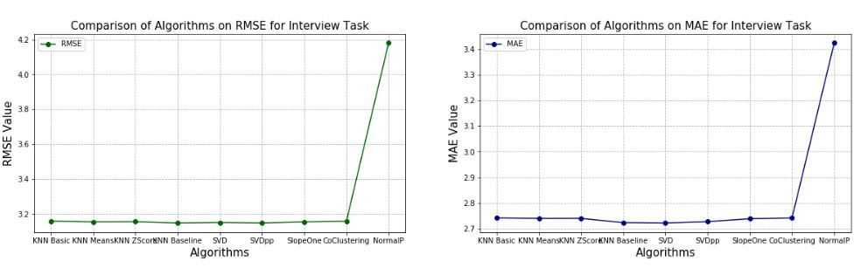
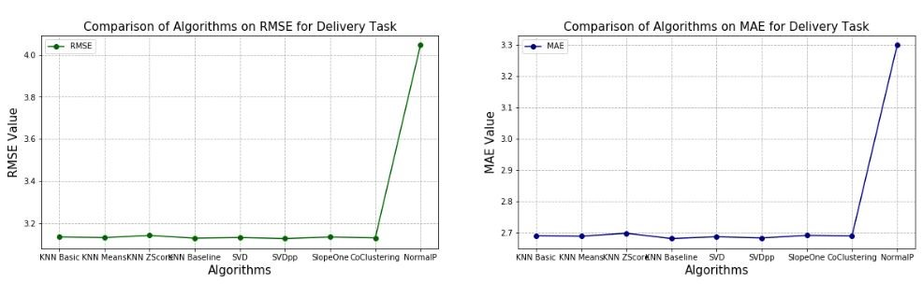
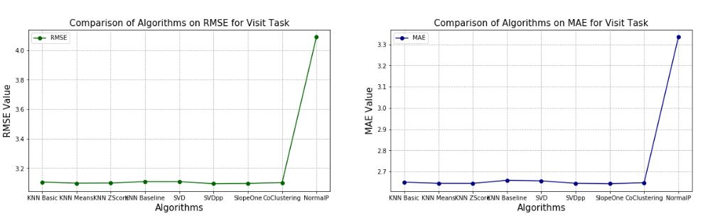
Baseline Comparison of Algorithms
Interview
Delivery
Visit

Slide 20
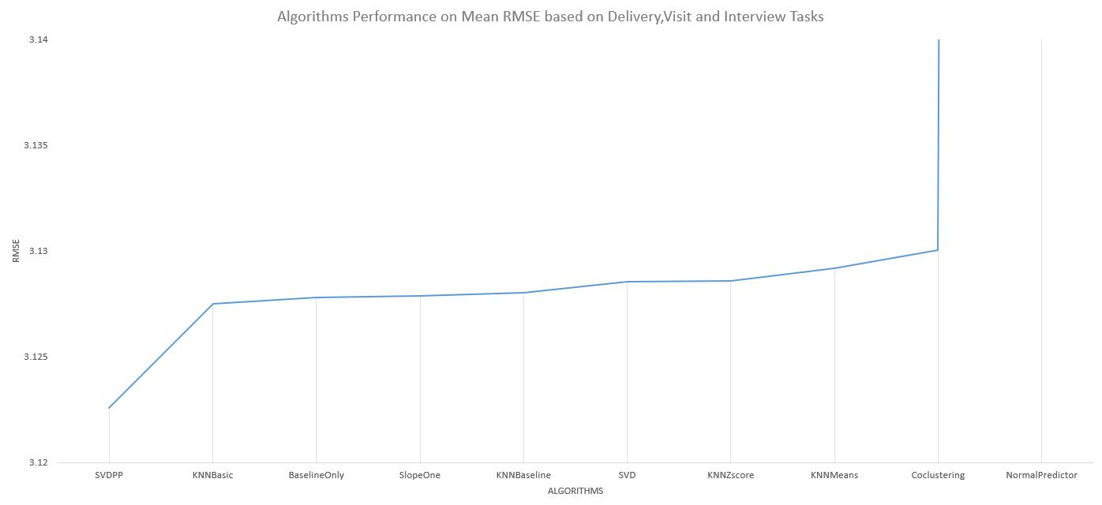
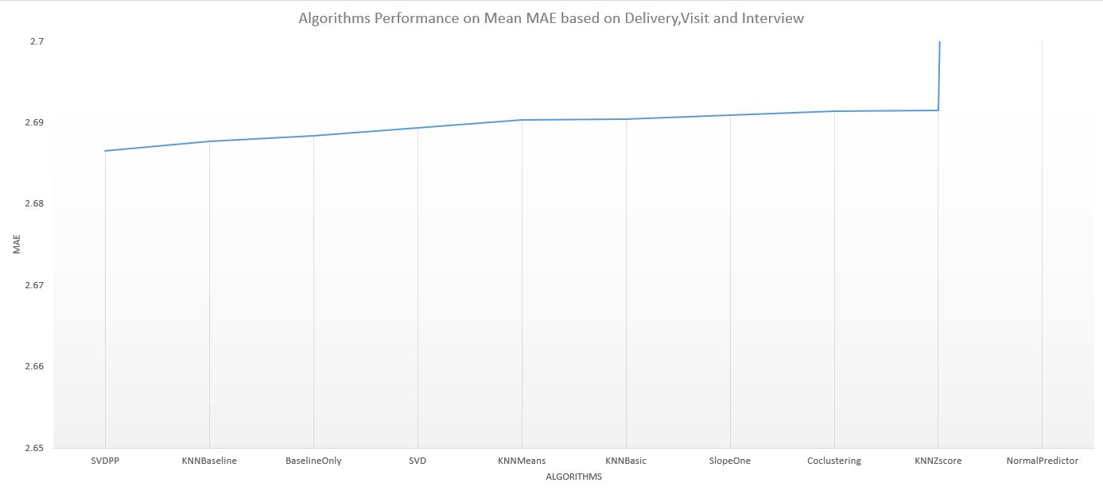
Baseline Comparison of Algorithms
Mean RMSE
Mean MAE

Slide 21
Quantitative Testing
In total 30 participants participated
15 CCBill employees
15 Non-CCBill employees
All of the participants found the application assisting for completing a given task such as locating an office
On average participants found augmented information as helpful (4.23)
On average participants found recommendation system as helpful (4.27)

Slide 22
Quantitative Testing (Cont.)
On average most participants agreed that the application was not affected by lighting and occlusion (1.63)
Interaction felt like natural and realistic (1.07)
Most users complained on the following issues
3D map was confusing
Unfortunately mostly to CCBill participants
Panning up and down
A greater amount found the application easy to use especially non-CCBill participants
CCBill participants found the recommendation system confusing as to how it functioned.

Slide 23
Challenges and Limitations
Choosing the right markers
Static markers
Dynamic markers
Must use deep learning techniques trained on all the variations of the marker.
Choosing the right user profiling to apply depending on the context in which they are used in
No pre-existing database
Vuforia cannot handle multiple model targets in one Unity scene
Used image targets
When activated the respective model target is then activated
Caused the panning issue where a slight delay occurs due to the application’s inability to quickly switch from image target to model target recognition

Slide 24
Future Work
Encourage the company gradually improve the recommendation algorithms they apply for profiling.
Random walk (if without a dataset), then apply an svd++, and finally make use of deep learning.
Real World interaction via augmented reality
Interact with real world devices such as lighting, printers, coffee machines and punch clocks.
Allow the users to also book an office on the spot when viewing information about it, making use of the company’s shared online calendar.
Include holographic live directions via location based AR
Would need to switch to ARKit or ARCore if the company prefers to invest in an indoor positioning system
Can use Vuforia by feeding the model targets 3D detailed models of the corridors.

Slide 25
Future Work (Cont.)
Include explainable AI
Interpret the models applied and their results
Improves transparency with human-interpretable explanations

Slide 26
To Conclude…
Vuforia traditional CV techniques and deep learning techniques were used in combination to provide the augmented reality side of the application.
Collaborative via SVD++ and item to item based similarity filtering techniques were used to provide the user profiling and recommendation component of the application.
11 markers were used in total including the coffee machine
Quantitative testing for performed on the AR and User profiling components
Distance, colour, rotation and occlusion variances were tested on the AR component
SVD++ on average performed best in comparison to other models in baseline testing.
Qualitative testing was performed on the overall application
On average the system achieved positive and promising results highlighting the applicability of the techniques applied and implemented for the context in which they were used in.
The results seem to be successful. However, one should not ignore or overlook the fact that there will always be room for improvement and innovation.

Slide 27
Acknowledgements
The faculty for allowing me to perform such research
Dr.Camilleri for her constant support and feedback.
CCBill for allowing me to carry out the research within their workplace.

Slide 28
References
T. Haritos and N. D. Macchiarella, “A mobile application of augmented reality for aerospace maintenance training,” in 24th Digital Avionics Systems Conference, vol. 1, Oct 2005, pp. 5.B.3–5.1.
C. P. de Miguel, “Arlodge : Context-aware recommender system based on augmented reality to assist on the accommodation search process,” 2014.
F. Cacheda, V. Carneiro, D. Ferna´ndez, and V. Formoso, “Comparison of collaborative ﬁltering algorithms: Limitations of current techniques and proposals for scalable, highperformance recommender systems,” TWEB, vol. 5, p. 2, 01 2011.
Z. Zhang, S. Shang, S. R. Kulkarni, and P. Hui, “Improving augmented reality using recommender systems,” in Proceedings of the 7th ACM Conference on Recommender Systems, ser. RecSys ’13. New York, NY, USA: Association for Computing Machinery, 2013, p. 173–176. [Online]. Available: https://doi.org/10.1145/2507157.2507211
V. Lepetit, “On computer vision for augmented reality,” 08 2008, pp. 13 – 16.
D. Procha´zka, O. Popelka, T. Koubek, J. Landa, and J. Kolomaznik, “Hybrid surfgolay marker detection method for augmented reality applications,” Journal of WSCG, vol. 20, pp. 197–204, 01 2012.
M. Garon and J.-F. Lalonde, “Deep 6-DOF tracking,” IEEE Transactions on Visualization and Computer Graphics, vol. 23, no. 11, 2017.

Slide 29
Why did you not include a navigation system?
Was not within the scope of my research due to the robustness of the implementation standalone from the implementation I myself made which was also robust in its nature.
Indoor positioning systems
Can generally be expensive to implement
The most inexpensive ones are Bluetooth and wifi based
Give a maximum error of 5m (Shah, Darshan & Shah, Kavish. (2012). Basic of Wi-Fi based positioning system. )
Why did you not include live directions?
Location-based AR
Indoor positioning system OR 3D photorealistic models of the entire workplace
Two very robust features
Going against company’s policy

Slide 30
Why did you create a dataset yourself and about its reliability?
It is a dataset generated solemnly for the AR prototype.
No similar pre-existing systems.
To test which model best to apply in the current context it was applied to.

Slide 31
How does the RS work?
Two user query models
Visitor
Collaborative + Item to item based similarity -> user query
Intern
((Sec/HR/Manager) + (GR,RestRooms,Kitchen)) + item to item based -> user query
Singular Value Decomposition
Decomposing vectors onto orthogonal axes
Any set of vectors(A) can be expressed in terms of their lengths of projections (S) on some set of orthogonal axes (V)
SVD++ takes implicit data into consideration hence the ++
A=U∑Vtranspose
Firstly compute A.V=S
A- matrix of points
V- matrix of decomposition
S- Matrix of the lengths of projections

Slide 32
How does the RS work? (SVD++ cont)
A = Svtranspose
Any set of vectors (A) can be expressed in terms of their lengths of projections (S) on some set of orthogonal axes (V).
S= U∑
Compute a column vector containing the lengths of projections of each point on first axis
Compute a column vector containing the lengths of projections of each point on second axis
Applying a division concept to the matrix of the two computations and balance them out by an identity matrix
Hence A=U∑Vtranspose
This works with a utility matrix of user ratings and tasked or locations of interest

Slide 33
Explain the AR part
Two object and image recognition techniques
Traditional computer vision
Recognise via edges and contours
Deep Learning techniques
CNN
Fed 3D Object
Creates frames (builds dataset)
Estimates pose
Edges and contours detected in each frame
Not much content with regards to exactly what architectures were applied since commercial library.

Slide 34
What is extended tracking?
Feature which allows Vuforia to track targets using natural features surrounding it.
Vuforia builds a map of features surrounding the target, maintaining detection even though not within camera view.

Slide 35
How does object recognition works using model targets
Interest point detection
Works by having a set of template images, capturing the object appearance and pre-deﬁned feature patterns. As features are detected by the tracker, they are compared to the features – interest points – of the template images and the orientation can be calculated
3D pose estimation is a process of predicting the transformation of an object from a user-defined reference pose.
Points are extracted edges and corners mostly
Reconstructs the image points
Can use the iterative closest point algorithm
Can handle occlusion
Estimation by comparison within phone using a database of points

Slide 36
How Does Model tracking work in Vuforia
Edge based method
Extracts contour and fit them to the models’ outlines
OR look for strong gradients in image around first estimation of the object pose without explicitly extracting contours – fast and general
RAPiD
Low computational complexity
Sampled control points along 3d model edges
Simple loop
Each fram prediciting pose= est pose visible with new location
Match and compares points
OR Explicit Edge Extraction
Globally match model primitives with primitives extracted from the image
RAPiD is more likely being use

Slide 37
Why did you choose SVD++ why not use deep learning straight away?
Not large enough dataset
For prototyping
Has already been done and compared with svd++

Slide 38
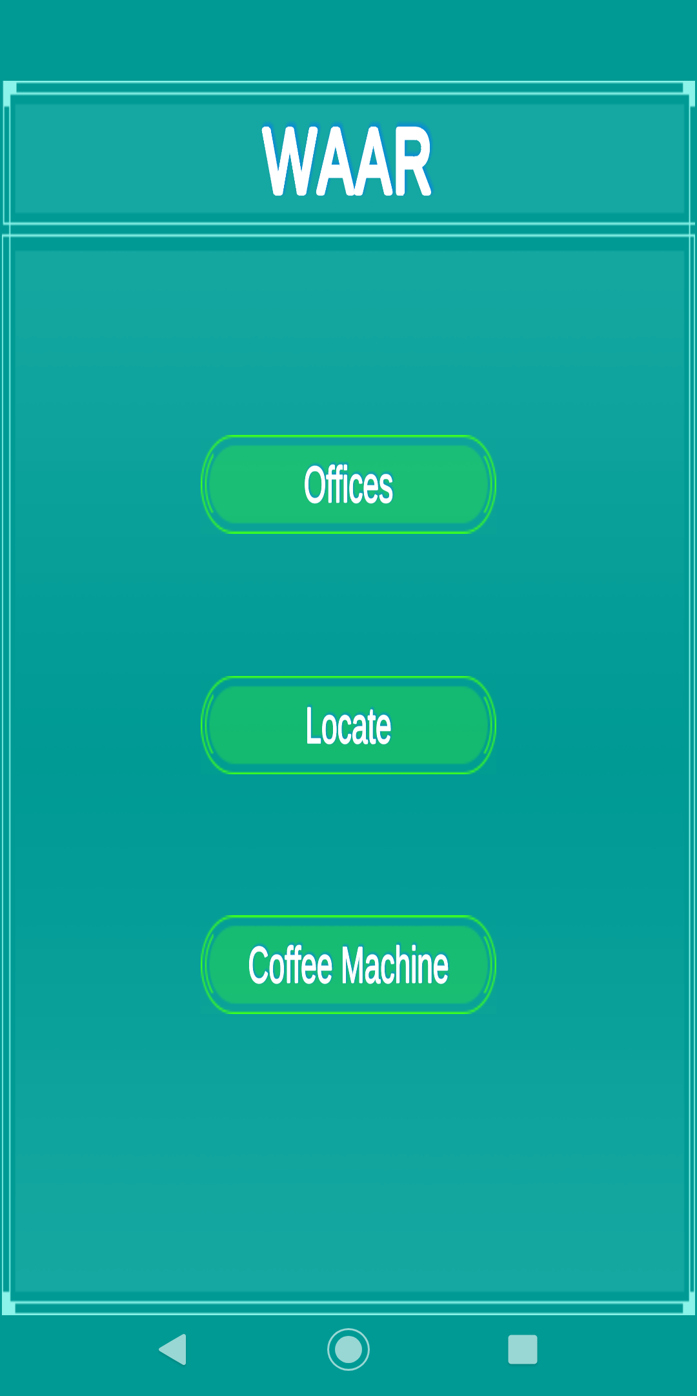
Main Menu

Slide 39
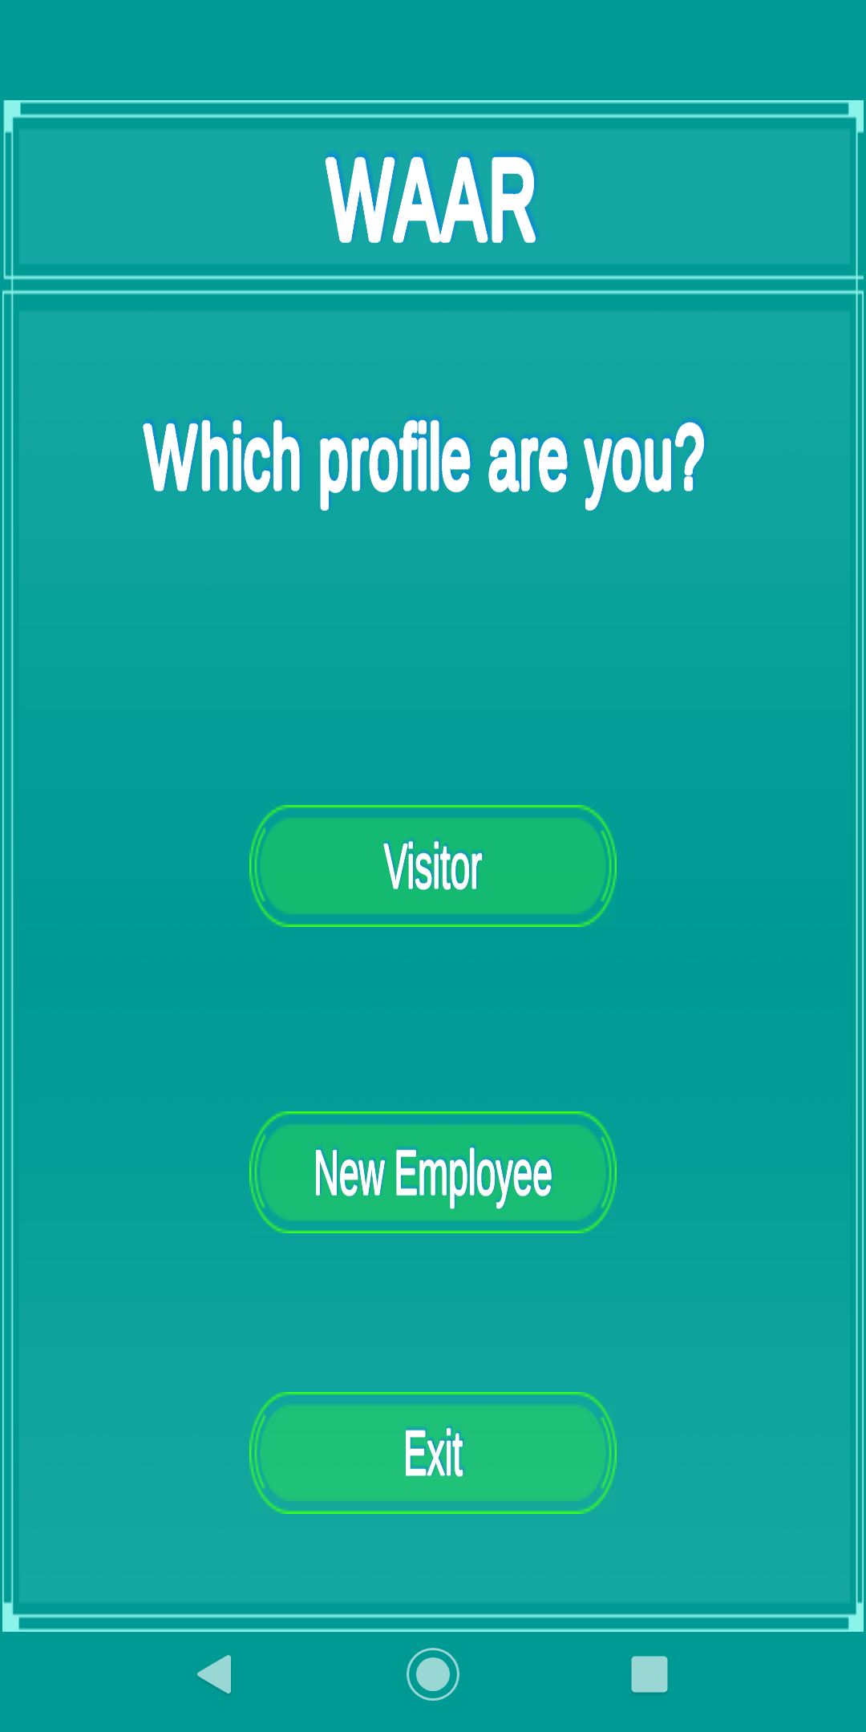
Choosing a user profile

Slide 40
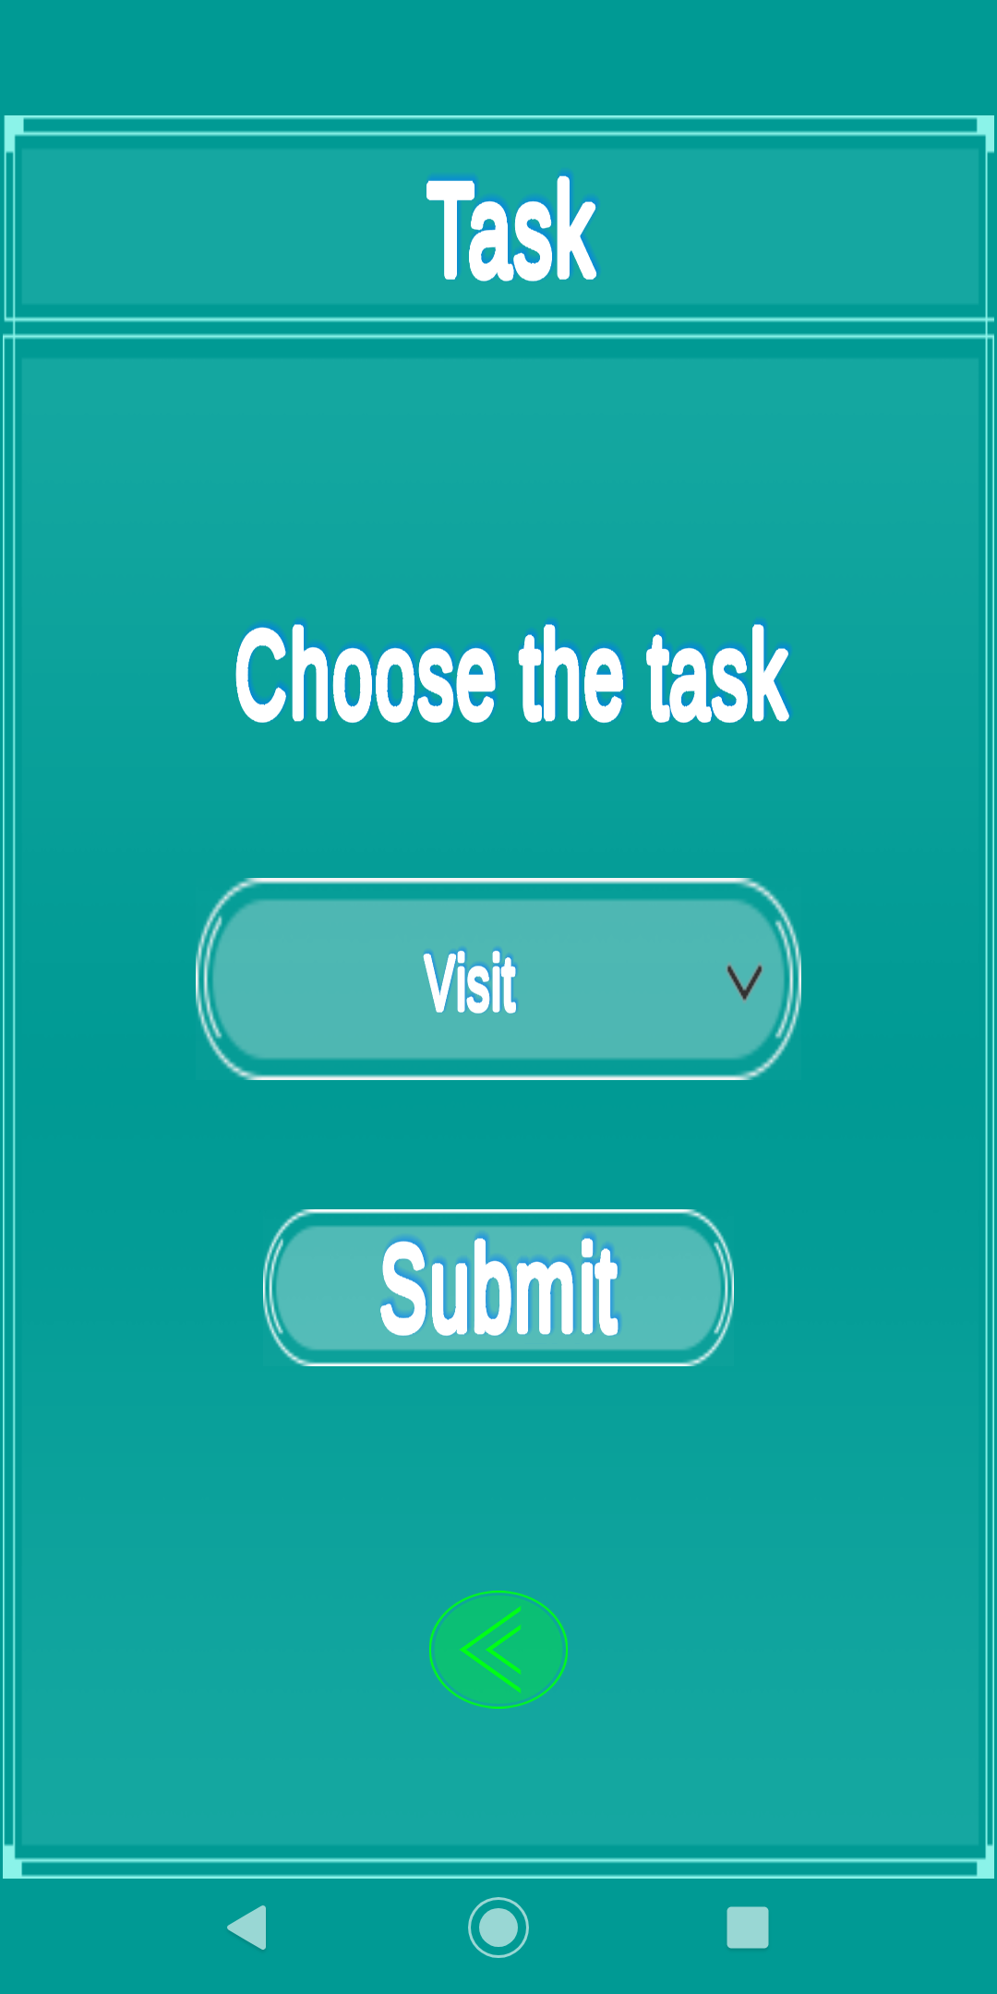
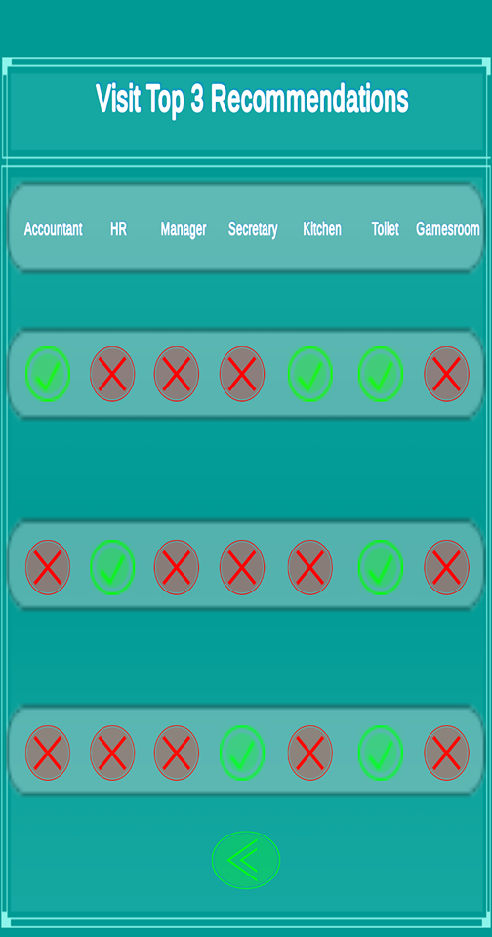
Visitor’s Section

Slide 41
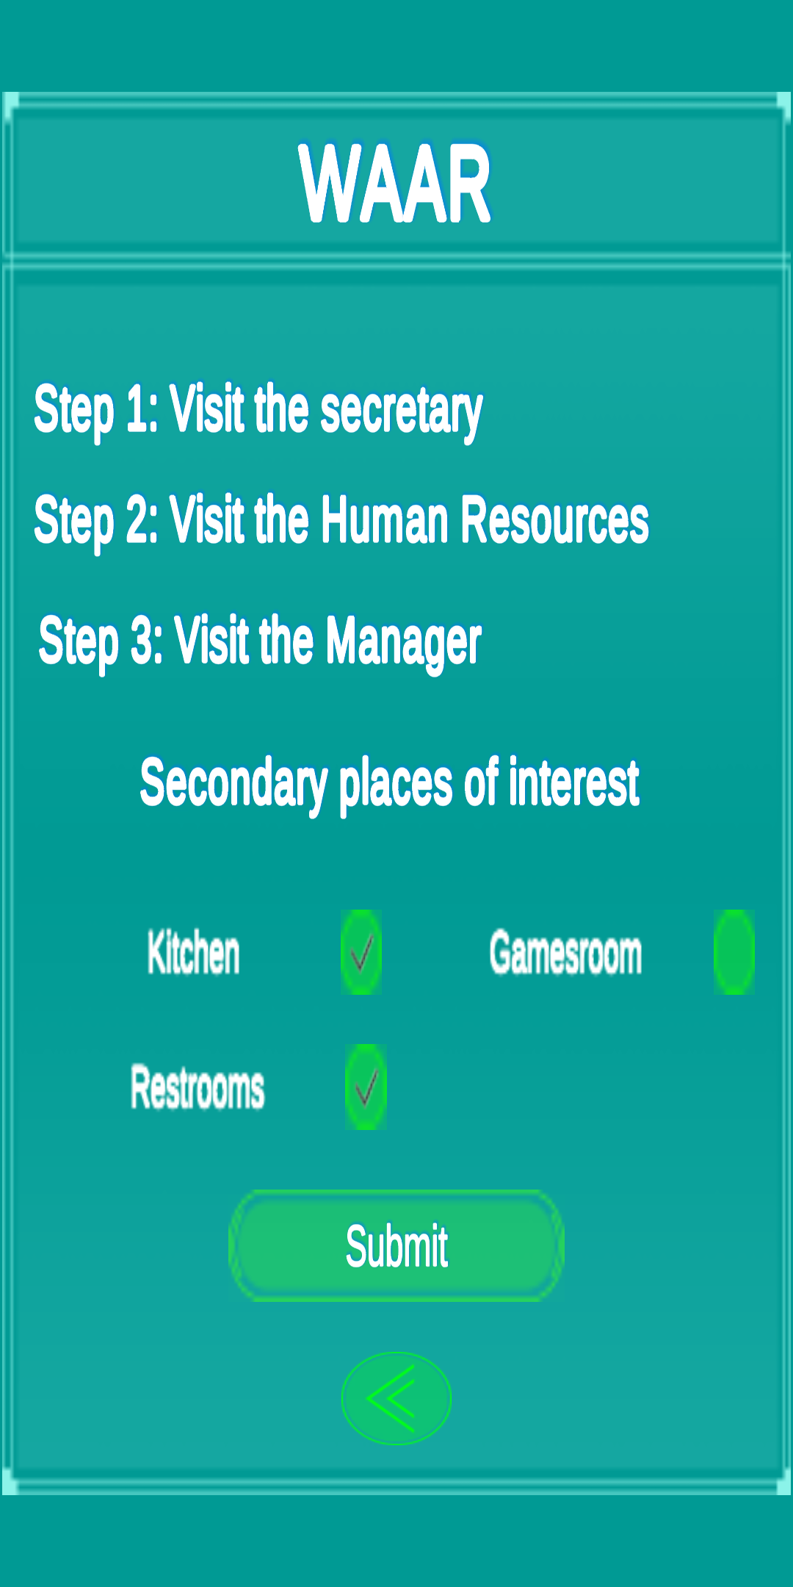
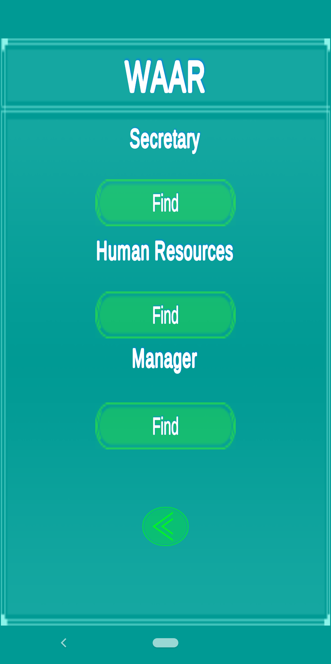
Intern’s Section

Slide 42
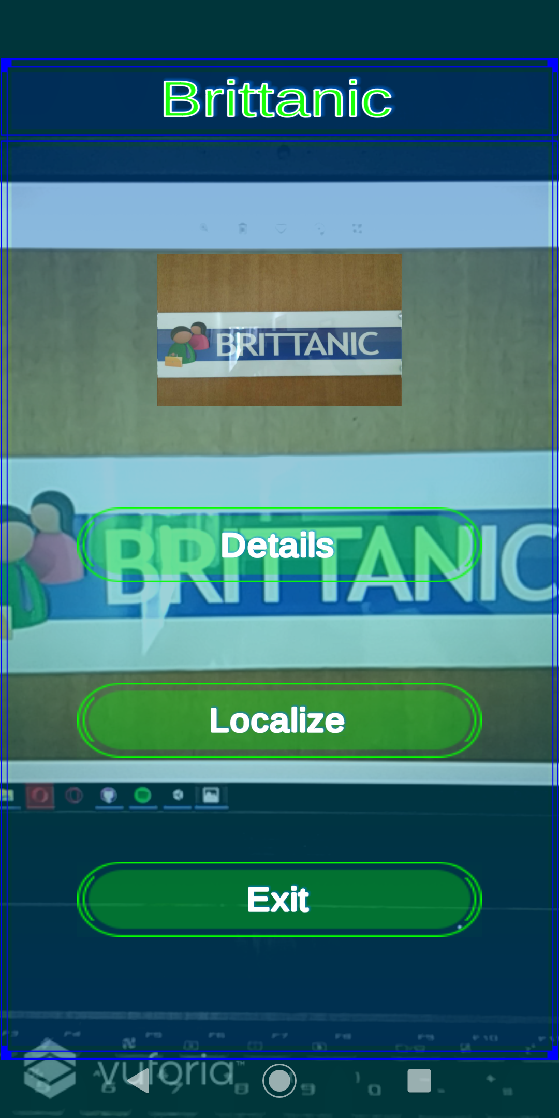
Augmented Reality Offices

Slide 43
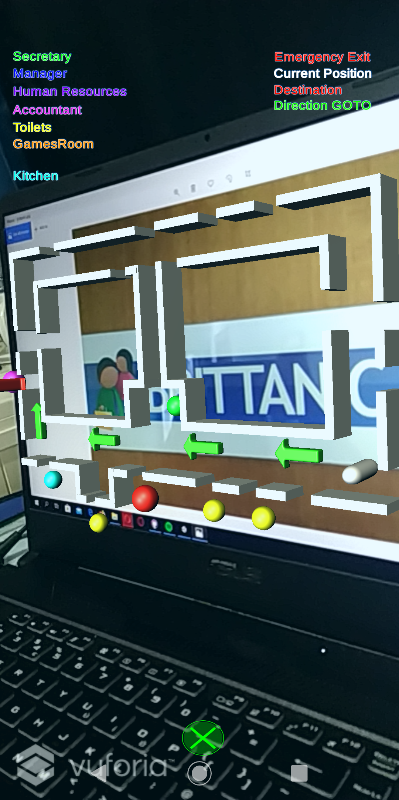
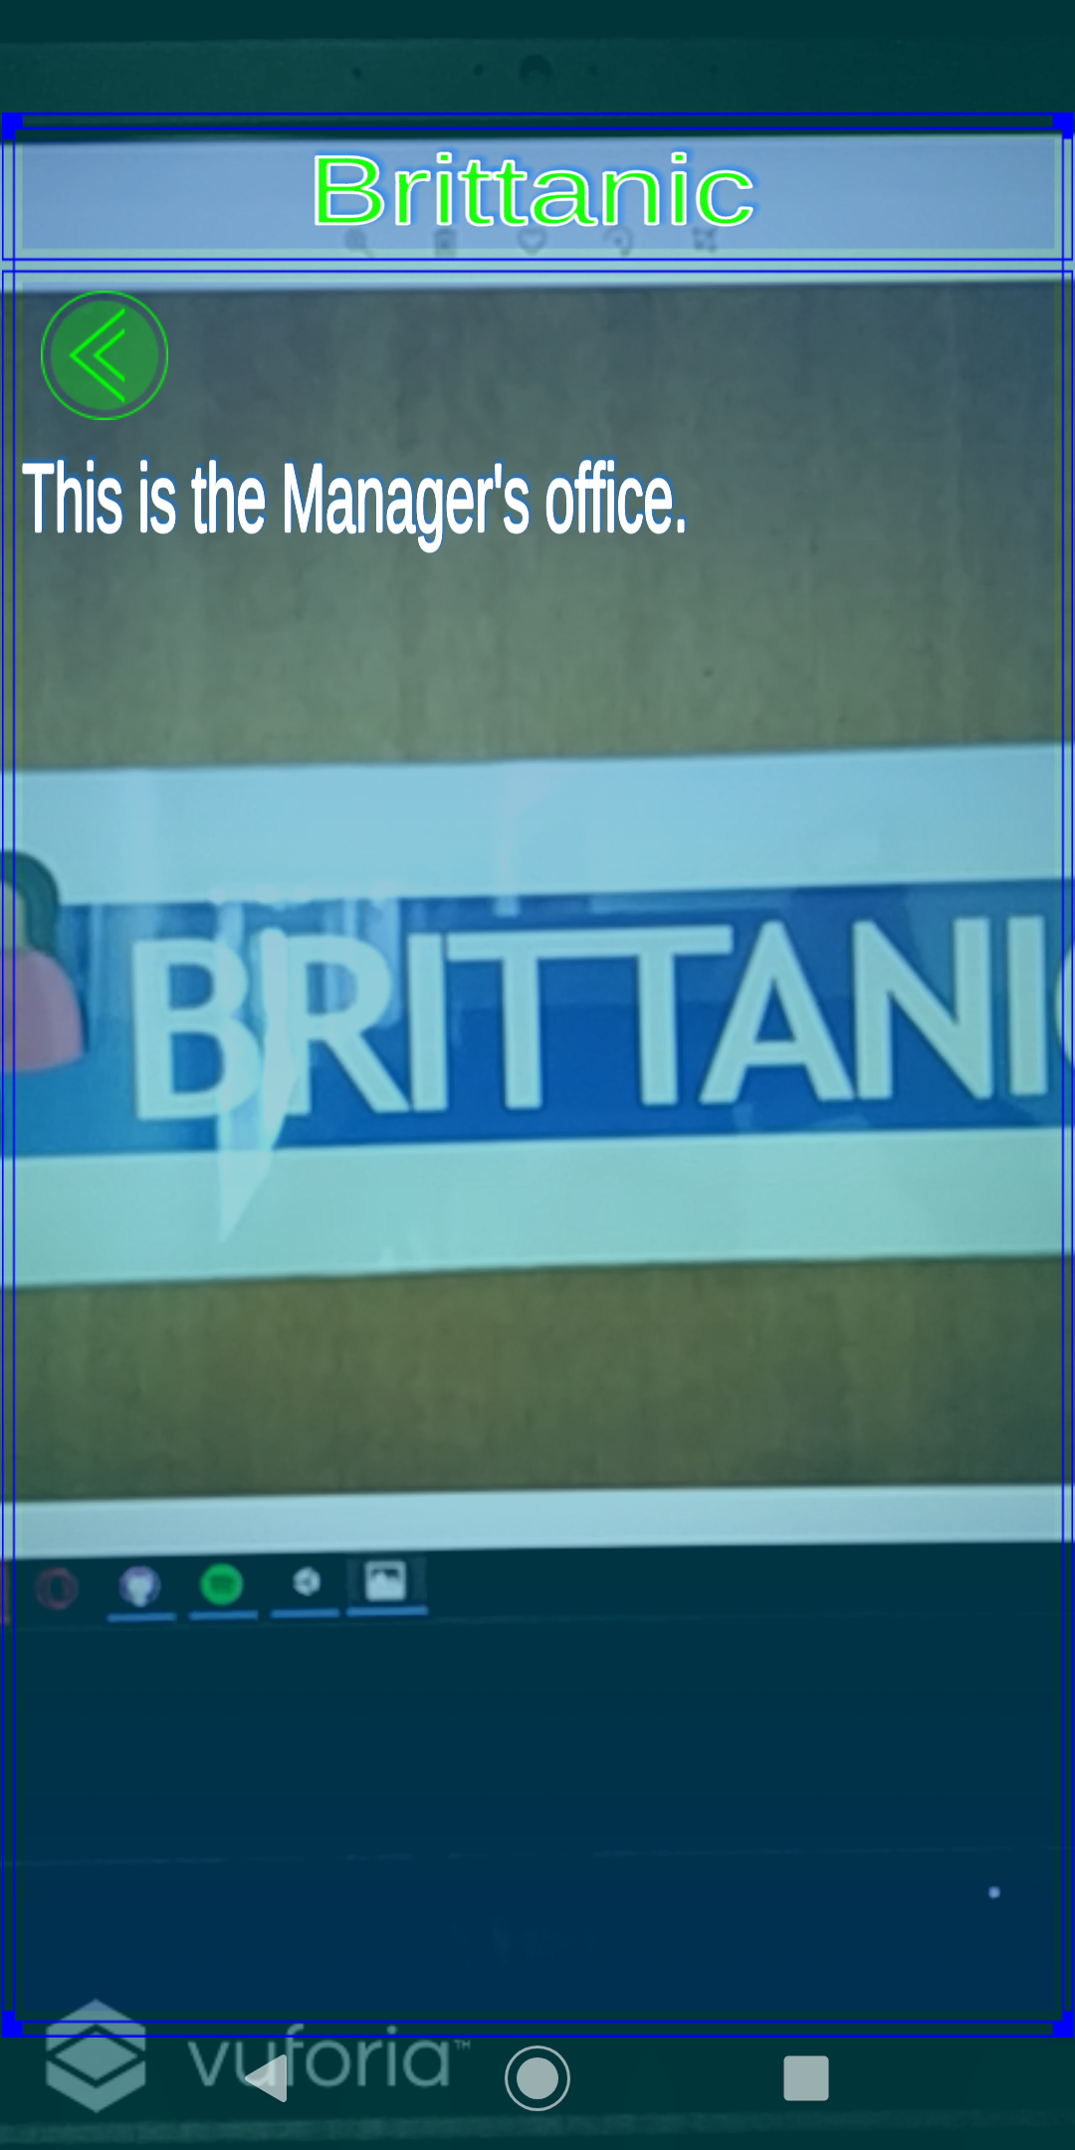
Augmented Reality Offices

Slide 44
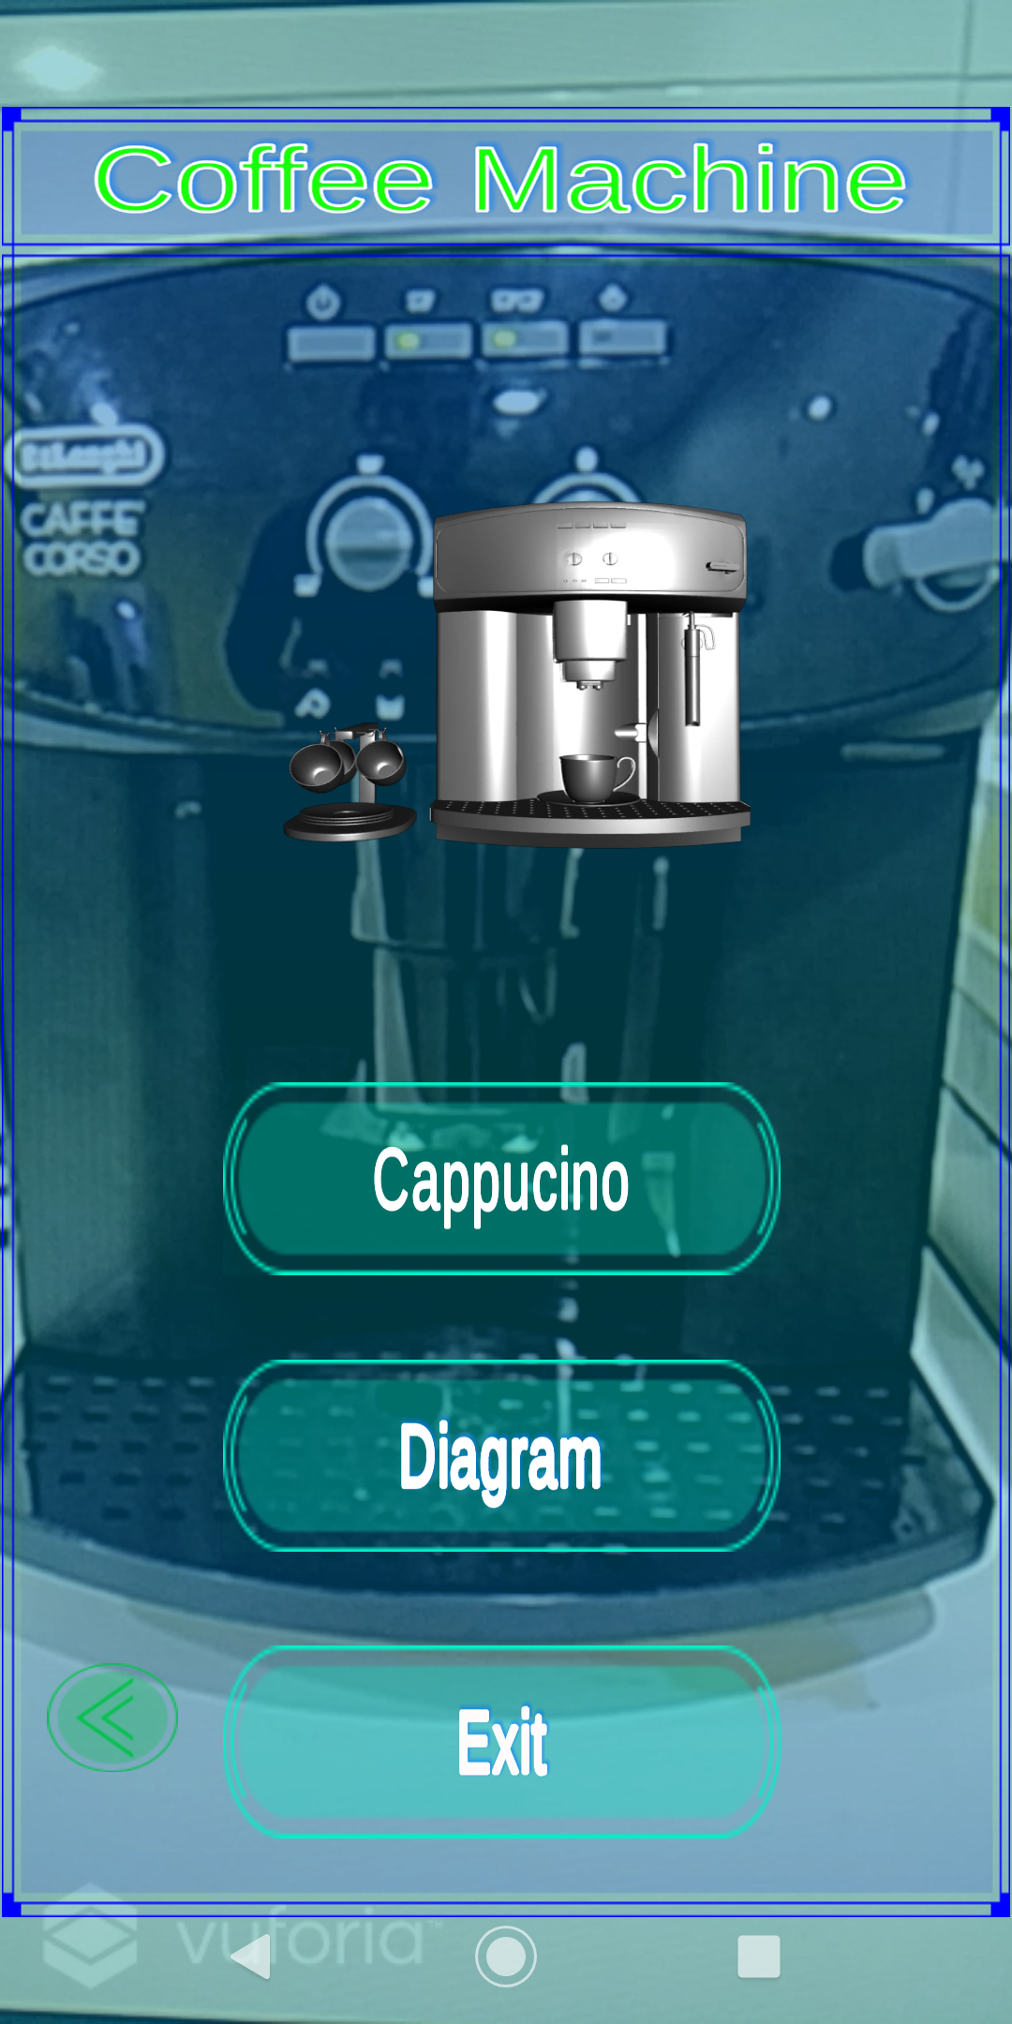
Coffee Machine

Slide 45
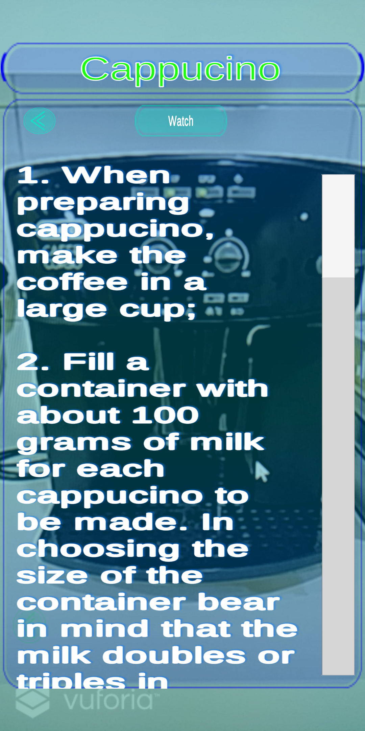
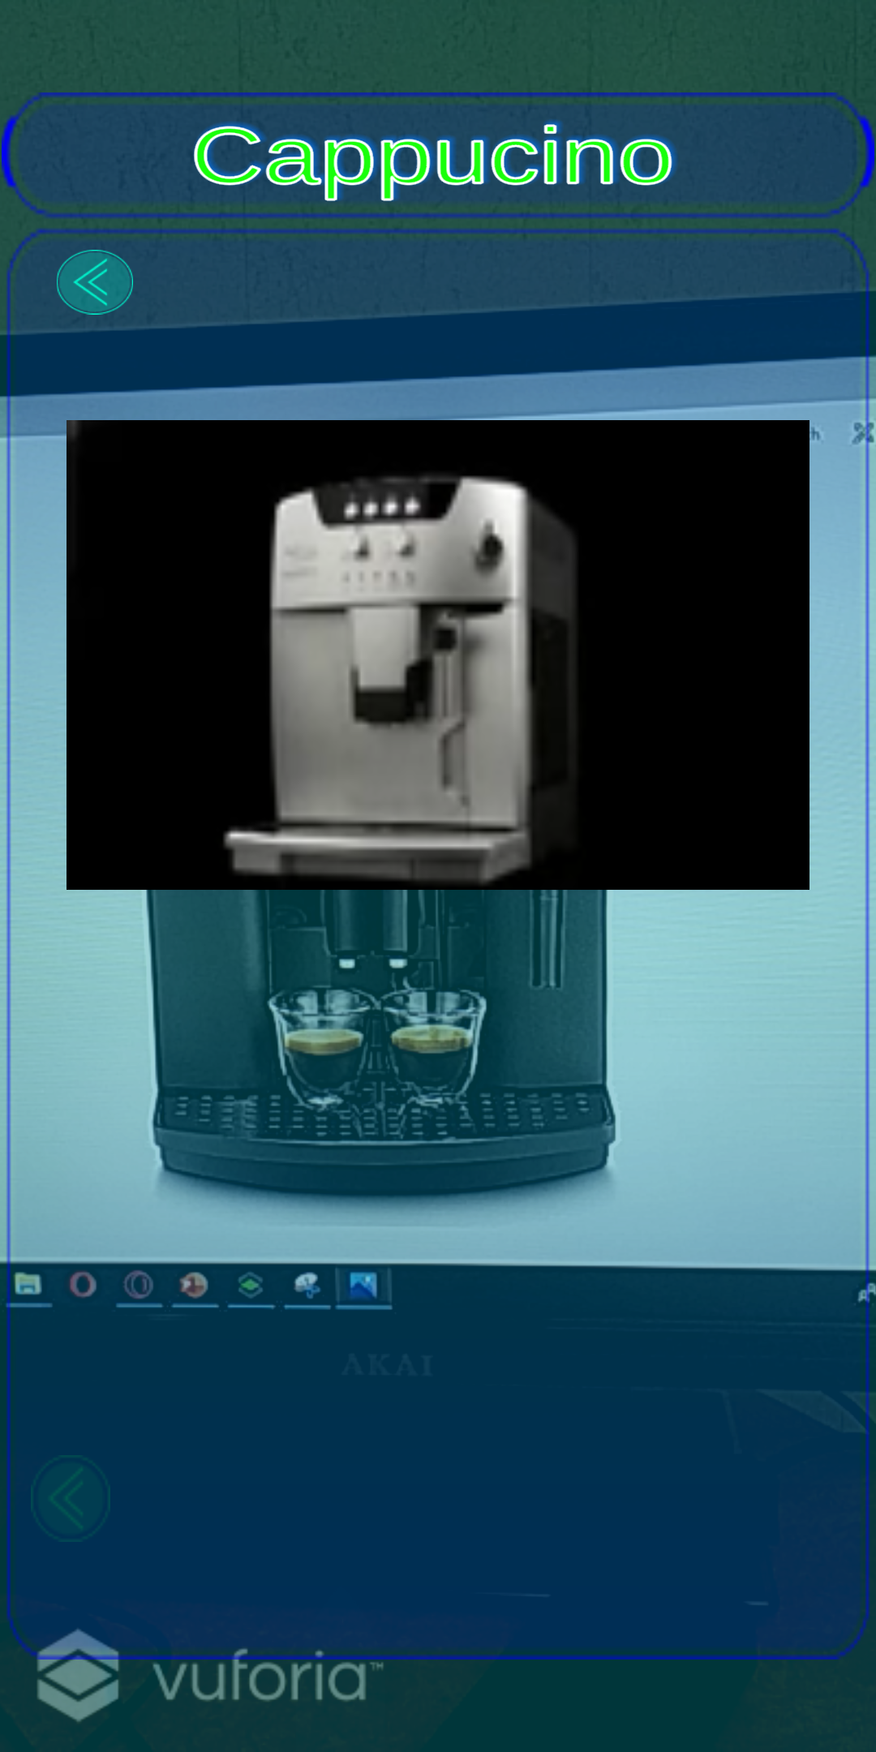
AR Coffee Machine Cappuccino Details

Slide 46
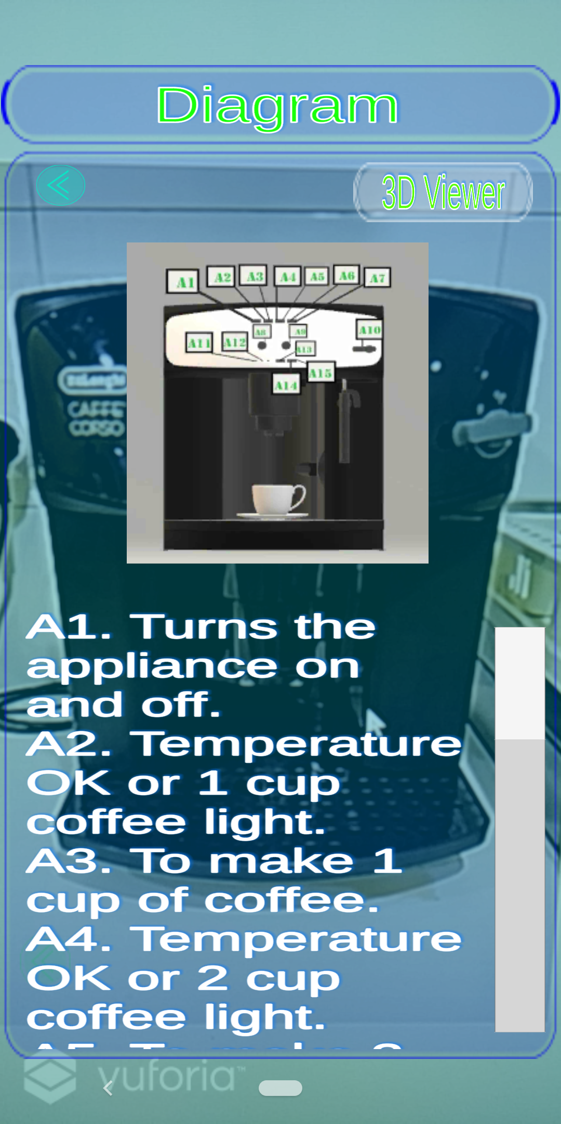
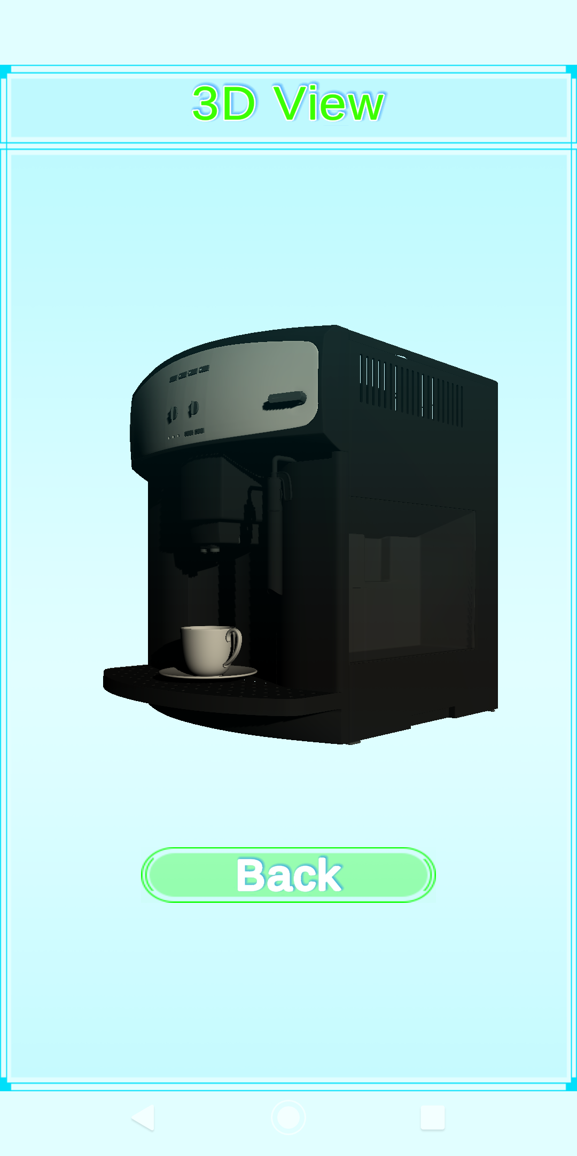
AR Coffee Machine Cappuccino Details

